Slide 1
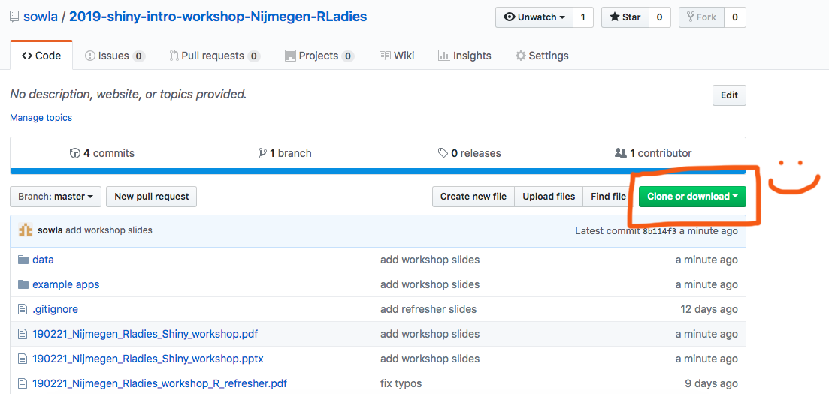
Please download this github repository: https://bit.ly/2BLmoGW

Slide 2

Introduction to
R-Ladies Nijmegen 21/02/19

Slide 3

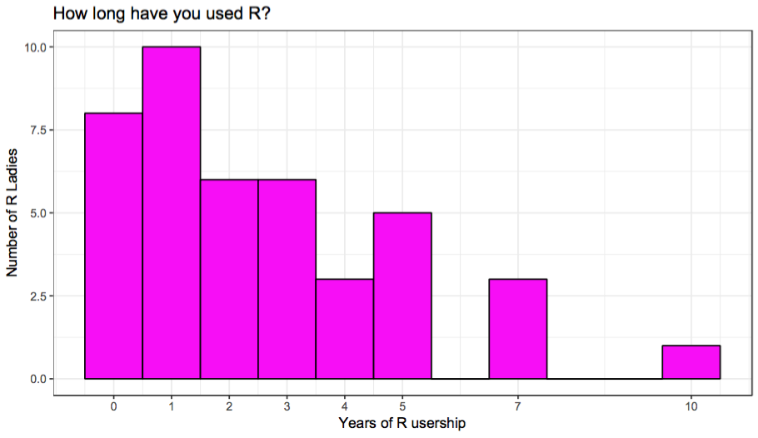


Hi!
I’m Suthira Owlarn :)
Biologist/postdoc in Kerstin Bartscherer’s lab
MPI for Molecular Biomedicine (Münster)
Hubrecht Institute (Utrecht)
R newbie (~1.5 years)
Shiny enthusiast!
@s_owla
sowla

Slide 4
Tonight’s plan
Introduction + demo
Build a sample app together (with short exercises)
Build your own app (longer hands-on session)
Q&A/summary

Slide 5

Tonight’s plan
Introduction + demo
Build a sample app together (with short exercises)
Build your own app (longer hands-on session)
Q&A/summary
GIF by
Mara Averick (@dataandme)

Slide 6
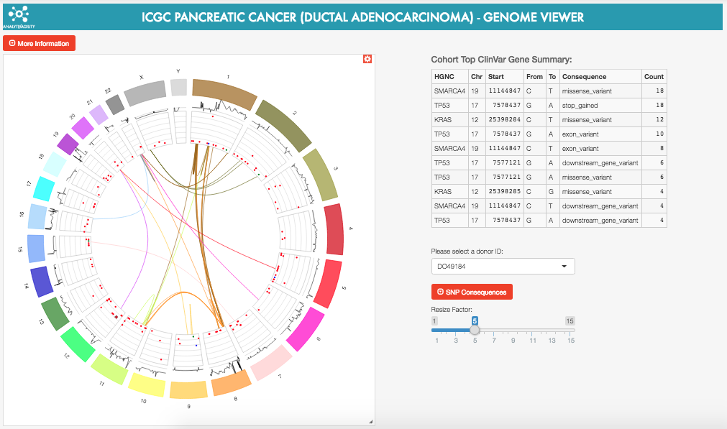
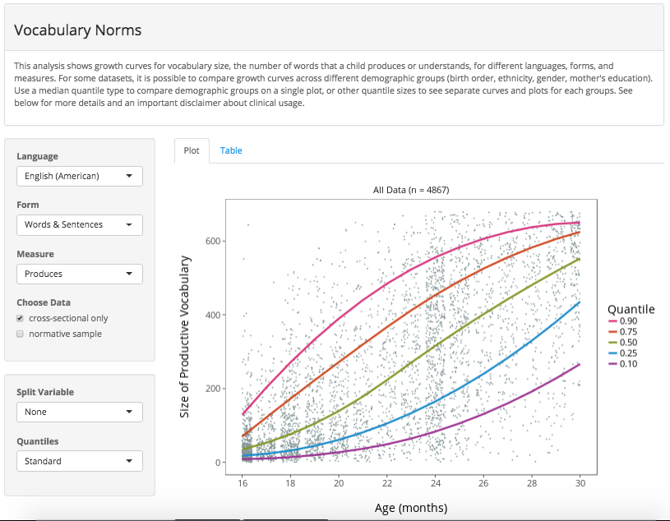
Shiny
A quick and easy way to provide a user-friendly interface to your analysis
ICGC pancreatic cancer genome viewer
Word Bank
shiny.rstudio.com/gallery

Slide 7
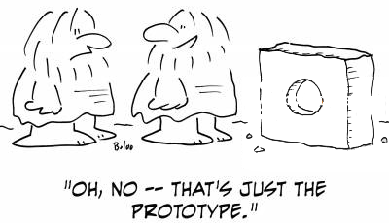
Demo

Slide 8
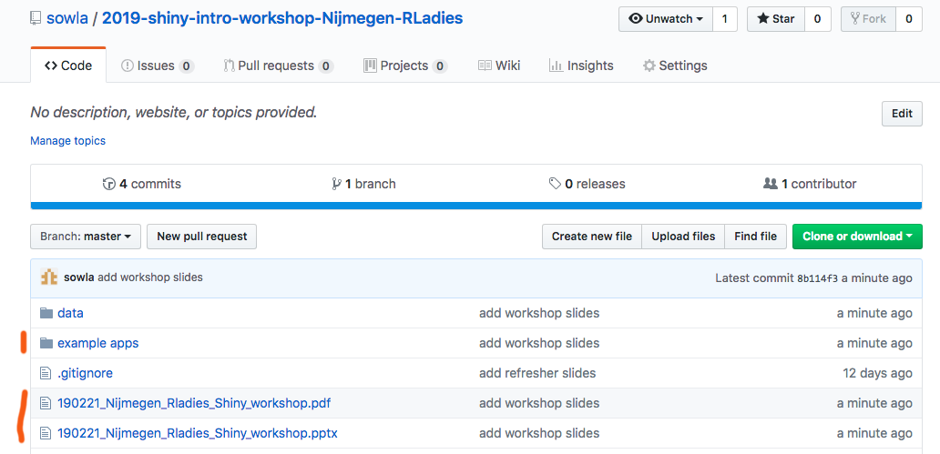
Getting started

Slide 9
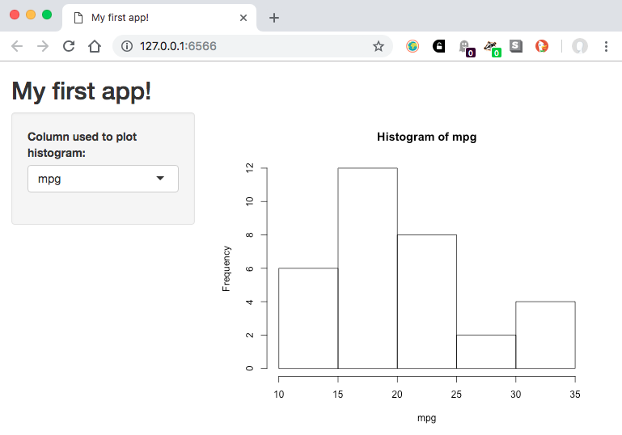
How does shiny work?
# plot a histogram
hist(
x = my_data[["mpg"]],
main = paste("Histogram of", "mpg"),
xlab = "mpg"
)
Translate R code into code for the user interface
Use R to do the calculations behind the scene

Slide 10
How does shiny work?
Shiny hides many of the complexities :D
Many possible inputs and outputs
Lots of other customisations possible
But first we’ll focus on building one app together, step-by-step

Slide 11
Our target shiny app
Let’s have a look at the app we’re trying to build:
Open 1-app-example.R
Start the app (“run app”; top right of script panel)
Explore the app
Stop the app (“stop”; top right of console panel)
If you have extra time:
Go back to the browser
What happens when you try to use the app? Why?
3-5 minutes

Slide 12
A minimal shiny app
2-app-very-basic1.R:
library(shiny)
shinyApp(
ui = "", # what to go on the web page
server = function(input, output) {} # calculations done in R
)

Slide 13
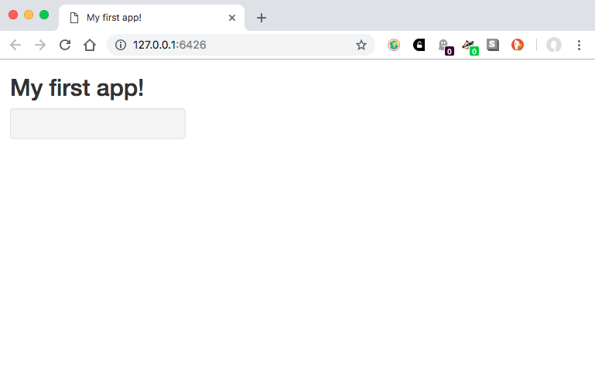
Building a user interface
ui <-
fluidPage(
titlePanel("My first app!"),
sidebarLayout(
sidebarPanel(),
mainPanel()
)
)

Slide 14
Building a user interface
ui <-
fluidPage(
titlePanel("My first app!"),
sidebarLayout(
sidebarPanel(),
mainPanel()
)
)

Slide 15
Building a user interface
ui <-
fluidPage(
titlePanel("My first app!"),
sidebarLayout(
sidebarPanel(),
mainPanel()
)
)

Slide 16
Building a user interface
ui <-
fluidPage(
titlePanel("My first app!"),
sidebarLayout(
sidebarPanel(),
mainPanel()
)
)
3-very-basic-app2.R

Slide 17
Building a user interface
Value of ui in 3-very-basic-app2.R:
<div class="container-fluid">
<h2>My first app!</h2>
<div class="row">
<div class="col-sm-4">
<form class="well"></form>
</div>
<div class="col-sm-8">
</div>
</div>
</div>
ui <-
fluidPage(
titlePanel("My first app!"),
sidebarLayout(
sidebarPanel(),
mainPanel()
)
)

Slide 18
Building a user interface: your turn
Could you open 3-very-basic-app2.R and:
change the title of your app?
move the sidebar panel to the right?
If you have extra time:
Did your neighbours use the same method as you?
There’s more than one way to do this! :)
3-5 minutes

Slide 19
Building a user interface: your turn
Canonical way:
Gives the same result:
ui <-
fluidPage(
titlePanel("My new title!"),
sidebarLayout(
position = "right",
sidebarPanel(),
mainPanel()
)
)
ui <-
fluidPage(
h2("My new title!"),
sidebarLayout(
mainPanel(),
sidebarPanel()
)
)

Slide 20
Building a user interface: your turn
My general mind set:
use the canonical way when there is one!
check documentation/internet for “lesser known” canonical way(s)
but don’t be afraid to be creative when there isn’t one! :)

Slide 21
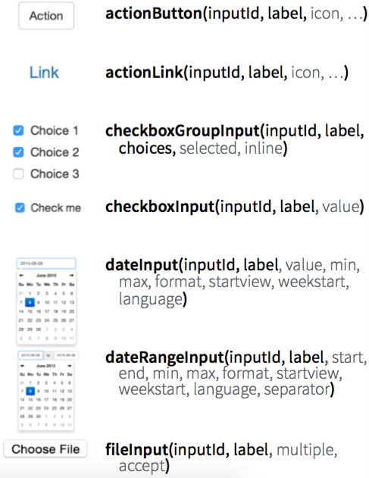
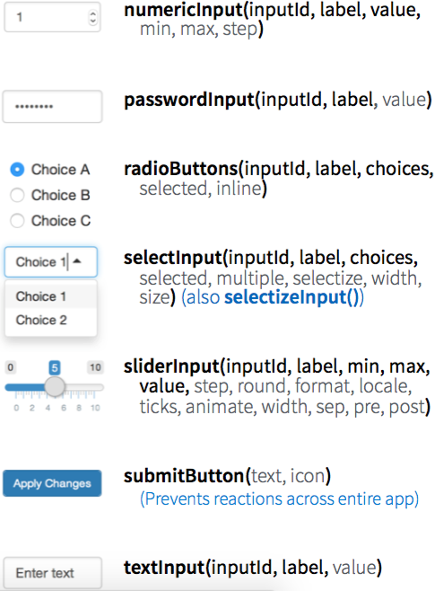
Building a user interface: inputs
From Rstudio’s Shiny cheatsheet

Slide 22
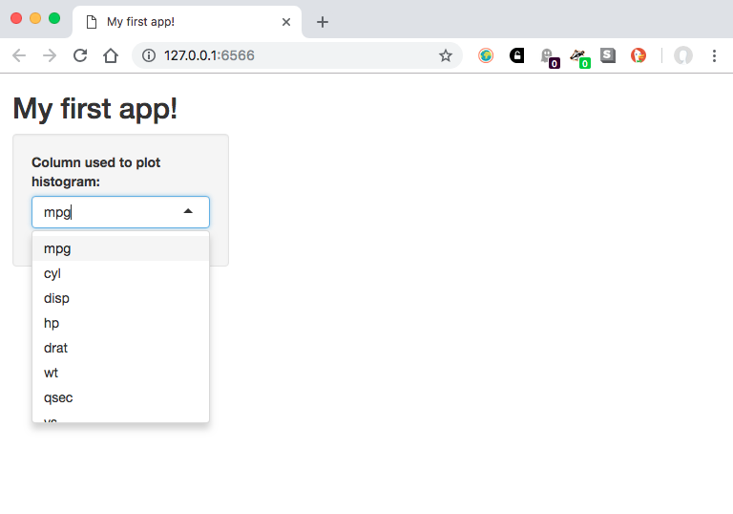
Building a user interface: inputs
sidebarLayout(
sidebarPanel(
selectInput(
inputId = "column",
label = "Column used to plot histogram:",
choices = names(mtcars)
)
),
mainPanel(
plotOutput(outputId = "plot")
)
)

Slide 23
Building a user interface: inputs
sidebarLayout(
sidebarPanel(
selectInput(
inputId = "column",
label = "Column used to plot histogram:",
choices = names(mtcars)
)
),
mainPanel(
plotOutput(outputId = "plot")
)
)
The input element goes in the sidebar panel

Slide 24
Building a user interface: inputs
sidebarLayout(
sidebarPanel(
selectInput(
inputId = "column",
label = "Column used to plot histogram:",
choices = names(mtcars)
)
),
mainPanel(
plotOutput(outputId = "plot")
)
)
Type of input
(dropdown menu)

Slide 25
Building a user interface: inputs
sidebarLayout(
sidebarPanel(
selectInput(
inputId = "column",
label = "Column used to plot histogram:",
choices = names(mtcars)
)
),
mainPanel(
plotOutput(outputId = "plot")
)
)
Unique ID so we can retrieve the correct values from it

Slide 26
Building a user interface: inputs
sidebarLayout(
sidebarPanel(
selectInput(
inputId = "column",
label = "Column used to plot histogram:",
choices = names(mtcars)
)
),
mainPanel(
plotOutput(outputId = "plot")
)
)
Label to show above the input

Slide 27
Building a user interface: inputs
sidebarLayout(
sidebarPanel(
selectInput(
inputId = "column",
label = "Column used to plot histogram:",
choices = names(mtcars)
)
),
mainPanel(
plotOutput(outputId = "plot")
)
)
Choices to give in the dropdown menu

Slide 28
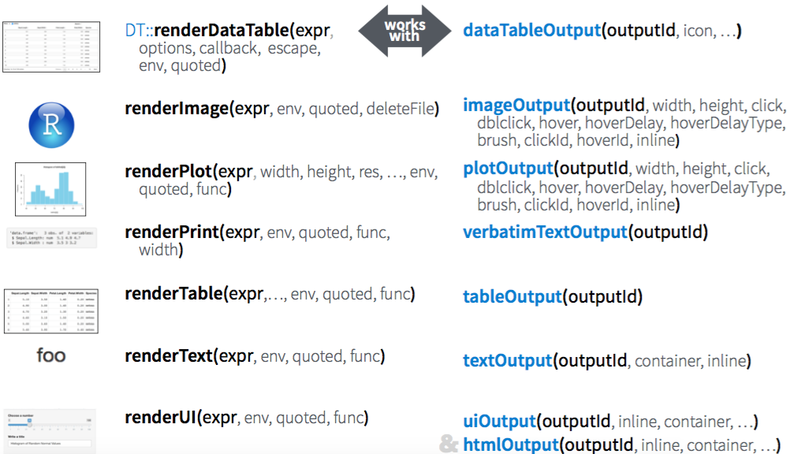
Building a user interface: outputs
From Rstudio’s Shiny cheatsheet

Slide 29
Building a user interface: outputs
sidebarLayout(
sidebarPanel(
selectInput(
inputId = "column",
label = "Column used to plot histogram:",
choices = names(mtcars)
)
),
mainPanel(
plotOutput(outputId = "plot")
)
)
The output element will go in the main panel

Slide 30
Building a user interface: your turn
Sticking with 3-very-basic-app2.R, could you:
add a selectInput element for selecting the my_data column to plot?
Don’t forget: input ID, label and choices
add a plotOutput area for the histogram?
Don’t forget: output ID
If you have extra time:
Type e.g. `?selectInput` to see available arguments and try changing some of the defaults!
10-15 minutes
Notes:
Answers: 4-app-with-ui.R

Slide 31
Building a user interface: summary
ui <- ""
server <- function(input, output) {
}
shinyApp(ui = ui, server = server)
...
selectInput(
inputId = "column",
label = "Column used to plot histogram:",
choices = names(my_data)
)
...
...
plotOutput(
outputId = "plot"
)
...
Start with a minimal template, then build on it
*Input() code:
- define input UI
(- where input UI goes)
*Output() code:
- what output accepted
(- where output goes)
Notes:
In this case, selectInput, but it could be textInput, sliderInput etc
In this case, plotOutput, but it could be …

Slide 32
Writing the server logic: revisiting outputs
From Rstudio’s Shiny cheatsheet

Slide 33
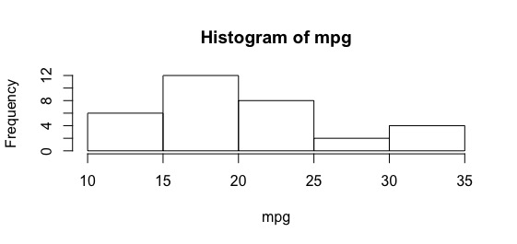
Writing the server logic: revisiting outputs
Generic R code:
# plot a histogram of mtcars$mpg
hist(
x = mtcars[["mpg"]],
main = paste("Histogram of", "mpg"),
xlab = "mpg"
)

Slide 34
Writing the server logic: revisiting outputs
Generic R code:
Shiny server code:
# plot a histogram of mtcars$mpg
hist(
x = mtcars[["mpg"]],
main = paste("Histogram of", "mpg"),
xlab = "mpg"
)
# shiny output version
output$plot <- renderPlot({
hist(
x = mtcars[["mpg"]],
main = paste("Histogram of", "mpg"),
xlab = "mpg"
)
})
Notes:
List of outputs

Slide 35
Writing the server logic: revisiting outputs
What kind of output (matches type in UI code)
# relevant ui code:
mainPanel(
plotOutput(outputId = "plot")
)
# relevant server code:
output$plot <- renderPlot({
hist(
x = mtcars[["mpg"]],
main = paste("Histogram of", "mpg"),
xlab = "mpg"
)
})
Notes:
Or eg. renderText() with textOutput()

Slide 36
Writing the server logic: revisiting outputs
Where the output should appear (matches output ID in UI code)
# relevant ui code:
mainPanel(
plotOutput(outputId = "plot")
)
# relevant server code:
output$plot <- renderPlot({
hist(
x = mtcars[["mpg"]],
main = paste("Histogram of", "mpg"),
xlab = "mpg"
)
})

Slide 37
Writing the server logic: revisiting outputs
`output` is a named list, values can be stored with the help of `$`
# relevant ui code:
mainPanel(
plotOutput(outputId = "plot")
)
# relevant server code:
output$plot <- renderPlot({
hist(
x = mtcars[["mpg"]],
main = paste("Histogram of", "mpg"),
xlab = "mpg"
)
})

Slide 38
Writing the server logic: your turn
Without looking at previous slides, could you:
Edit the server logic as explained in 5-app-with-server.R
If you have extra time:
What other attributes in the output might you want to change?
What kind of inputs would you need?
Which input elements might be suitable for them? (see this widget gallery for ideas)
3-5 minutes
Notes:
Now we have a plot! But the output isn’t linked to the input in anyway..

Slide 39
Writing the server logic: linking inputs and outputs
Incorporating the input in the output code:
what does our input data look like?
can’t type into console while shiny app is running..
print() and cat() are your friends!
Let’s try with 6-app-with-server2.R
Reactivity: notice the code is rerun every time we pick a new input
-> this is why the output will update as the input changes

Slide 40
Writing the server logic: linking inputs and outputs
`input` is also a named list; values can be retrieved with `$`
# relevant ui code:
selectInput(
inputId = "column",
label = "Column used to plot histogram:",
choices = names(mtcars)
)
# linked to input
output$plot <- renderPlot({
hist(
x = mtcars[[input$column]],
main = paste("Histogram of", input$column),
xlab = input$column
)
})
Notes:
List of inputs

Slide 41
Writing the server logic: linking inputs and outputs
Which input to retrieve data from (matches input ID in UI code)
# relevant ui code:
selectInput(
inputId = "column",
label = "Column used to plot histogram:",
choices = names(mtcars)
)
# linked to input
output$plot <- renderPlot({
hist(
x = mtcars[[input$column]],
main = paste("Histogram of", input$column),
xlab = input$column
)
})
Notes:
List of inputs

Slide 42
Writing the server logic: your turn
Without looking at previous slides, could you:
Edit the server logic in 6-app-with-server2.R so the output changes depending on the input
If you have extra time:
What other attributes in the output might you want to change?
What kind of inputs would you need?
Which input elements might be suitable for them? (see this widget gallery for ideas)
3-5 minutes
Notes:
Answer: reached target app (7)

Slide 43
Building a user interface: summary
output$plot <- renderPlot({
hist(x =
mtcars[[input$col]]
)
})
output$plot <- renderPlot({
hist(x =
mtcars[[input$col]]
)
})
output$plot <- renderPlot({
hist(x =
mtcars[[input$col]]
)
})
Use input values in calculation function with input$input_id
Wrap calculation function with render*().
Assign function output to output$output_id

Slide 44
Adding complexity: reading data from a file
see 8-csv-data.R
Before:
After:
# "read in" data
my_data <- mtcars
# read in data
my_data <-
read.csv("../data/mtcars.csv", row.names = 1)

Slide 45
Adding complexity: reading data from a file
Before:
After:
First column is row names
# "read in" data
my_data <- mtcars
# read in data
my_data <-
read.csv("../data/mtcars.csv", row.names = 1)
Function to read file
Path to file

Slide 46
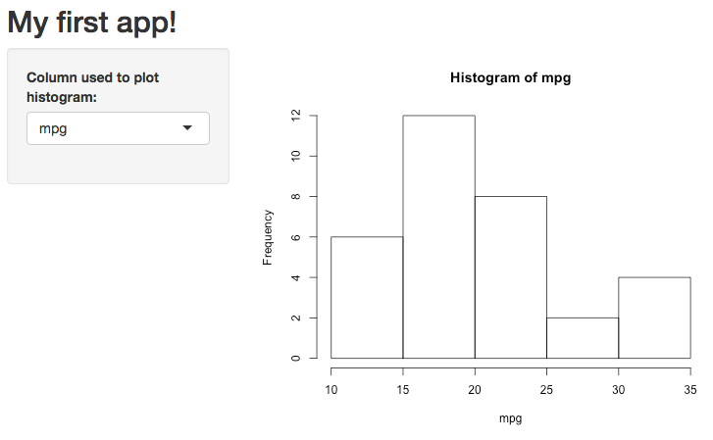
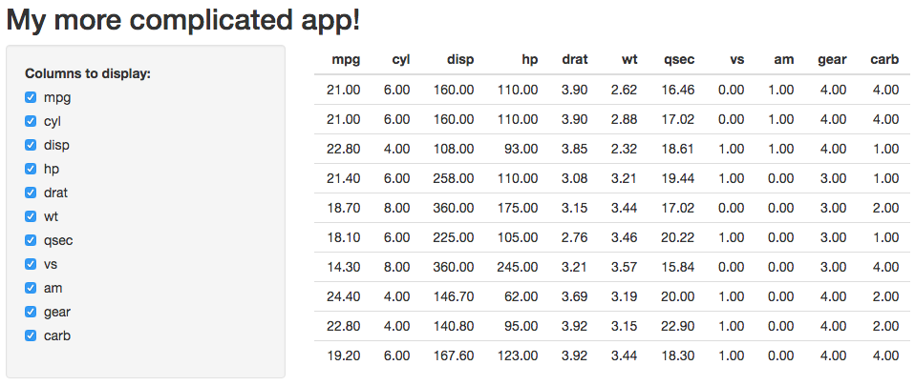
Adding complexity: replacing inputs/outputs
see 9-replace-io.R
Before:
After:

Slide 47
Adding complexity: replacing inputs/outputs
Change output
# relevant ui code:
mainPanel(
tableOutput(outputId = "table")
)
# relevant server code:
output$table <- renderTable({
mtcars[1:10]
})

Slide 48
Adding complexity: replacing inputs/outputs
Change output
# relevant ui code:
mainPanel(
tableOutput(outputId = "table")
)
# relevant server code:
output$table <- renderTable({
mtcars[1:10]
})

Slide 49
Adding complexity: replacing inputs/outputs
How do you plan to transform the data?
# relevant ui code:
checkboxGroupInput(
inputId = "columns",
label = "Columns to display:",
choices = names(my_data),
selected = names(my_data)
)
# relevant server code:
output$table <- renderTable({
mtcars[1:10, 1:3, drop = FALSE]
})
Pick which column(s) to show

Slide 50
Adding complexity: replacing inputs/outputs
What’s the corresponding input for that?
# relevant ui code:
checkboxGroupInput(
inputId = "columns",
label = "Columns to display:",
choices = names(my_data),
selected = names(my_data)
)
# relevant server code:
output$table <- renderTable({
mtcars[1:10, 1:3, drop = FALSE]
})

Slide 51
Adding complexity: replacing inputs/outputs
What does your input look like?
# relevant ui code:
checkboxGroupInput(
inputId = "columns",
label = "Columns to display:",
choices = names(my_data),
selected = names(my_data)
)
# relevant server code:
output$table <- renderTable({
cat(input$columns)
class(input$columns)
mtcars[1:10, 1:3, drop = FALSE]
})

Slide 52
Adding complexity: replacing inputs/outputs
Link input to output
# relevant ui code:
checkboxGroupInput(
inputId = "columns",
label = "Columns to display:",
choices = names(my_data),
selected = names(my_data)
)
# relevant server code:
output$table <- renderTable({
mtcars[1:10, input$columns,
drop = FALSE]
})

Slide 53
Adding complexity: your turn!
Multiple inputs
using two variables and adding shape/colour option
allowing users to add their own text for title/labels
giving a choice between base and ggplot
Multiple/different outputs
add table of summary statistics
add a logo and text summarising data
Different data
read in your own data
use the survey data
Until 8:10pm

Slide 54
Reminder: inputs
From Rstudio’s Shiny cheatsheet

Slide 55
Reminder: revisiting outputs
From Rstudio’s Shiny cheatsheet

Slide 56
Adding complexity: your turn (more advanced)!
Do you plan to have users upload their data onto your app?
Example in: 10-uploaded-data.R
Requires reactive(), observeEvent() and req()
Until 8:10pm

Slide 57
Tips
My general workflow
Analyse/visualise the data until you’re clear what you want to show
Write functions that work outside of a shiny app
Imagine/draw the layout, then write the UI code (provides structure)
Edit the functions into server code
Repeat if you want to add more features!
Cmd/ Ctrl + I to auto-indent for readability
cat(), print() and verbatimText for simple debugging

Slide 58
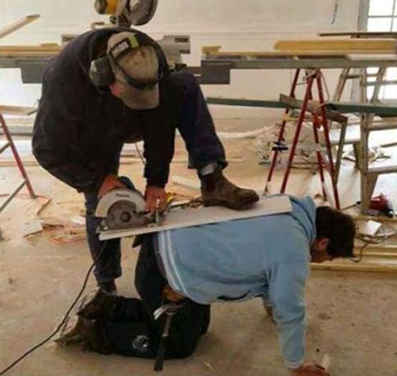


Slide 59
Tools/resources that make our lives easier
shiny.rstudio.com
gallery
tutorial, cheatsheet
reference or type ?<function_name> in your console
articles, e.g. debugging shiny apps (quite different from normal scripts)
Shiny section of Rstudio community
More from me:
shiny “extensions” talk and corresponding notes for more tools!
feel free to ask me questions: @s_owla on twitter :)

Slide 60
Tools/resources that make our lives easier: your turn!
I (and I think many others) would love to learn from you! :)
R-Ladies chapters
R user groups
R-Ladies rotating curator twitter account
Put your code on github
Share your ideas/code/writing on #rstats twitter
So many more ways!!
On-going! :)

